Slide 1
Java Web
Java Web Introduction
(Apache Tomcat)

Slide 2
Disclaimer
Document Name:
Data Classification: INTERNAL
Disclaimer
The contents of this document are property of Softtek, and are classified as Confidential. Any reproduction in whole or in part is strictly prohibited without the written permission of Softtek.
This document is subject to change. Comments, corrections or questions should be directed to the author.
Audience/Viewership | Purpose
Java Beginners | Training
Revision Chart
The following chart list the revisions made to this document. Use this to describe the changes and additions each time this document is re-published. The description should be detailed as possible and include the names of the reviewers who request the changes.
Version No. | Version Date | Types of Changes | Owner/Author | Date of Review/Expiration
1 | 2015/08/04 | Creation | Luis Robles | NA

Slide 3
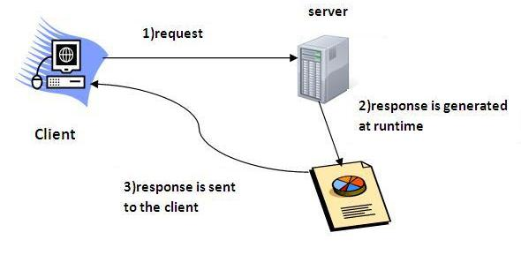
Lesson 1: Java Web Introduction (Apache Tomcat)

Slide 4
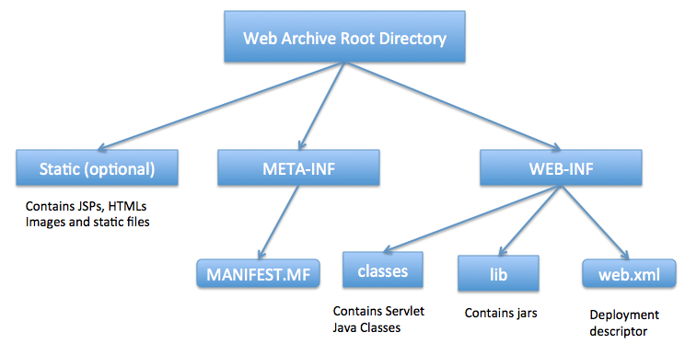
Java Web Application
A Java web application generates interactive web pages containing various types of markup language (HTML, XML, and so on) and dynamic content.
It is typically comprised of web components such as JavaServer Pages (JSP), servlets and JavaBeans to modify and temporarily store data
Java Servlet and JSPs are server side technologies to extend the capability of web servers by providing support for dynamic response and data persistence.
Interact with databases and web services
Render content in response to client requests.
It can be deployed as a WAR (Web ARchive) file
Java web application require a web container, such as Tomcat
Notes:
Briefing about Web Descriptor file (web.xml)

Slide 5
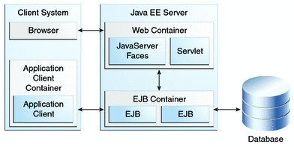
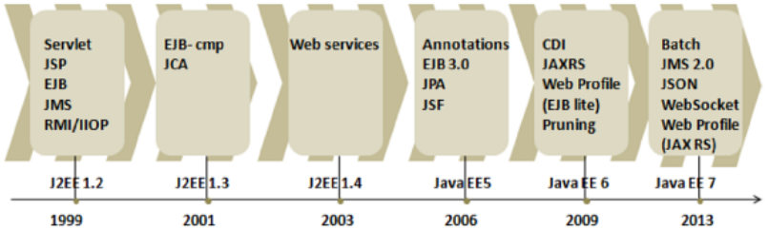
The evolution of JavaEE
Java EE: Java Enterprise Edition
Java EE platform is driven by two goals:
Providing the API specifications that are the building blocks of the web application.
Standardizing and reducing the complexity of enterprise application development. It does this by providing an application model that defines an architecture for implementing services as multitiered applications.

Slide 6
WebServer vs ApplicationServer
Web Server or HTTP Server is designed to serve HTTP Content (mostly designed to serve static content).
In Java: Web Container or Servlet Container or Servlet Engine : is used to manage the components like servlets, JSP . It is a part of the web server
It is possible to run most of the JavaEE technologies on a servlet-container, but you have to install a standalone implementation of the particular technology
An application server supports the whole JavaEE (whole JEE stack) - EJB, JMS, CDI, JTA, the servlet API (including JSP, JSTL), etc.
App Server can also serve HTTP Content but is not limited to just HTTP. It can be provided other protocol support such as RMI/RPC
App Server can do whatever Web Server is capable of. Additionally App Server have components and features to support Application level services such as Connection Pooling, Object Pooling, Transaction Support, Messaging services, etc.
Notes:
Describe some differences among WebServer, WebContainer, EJB Container, Application Server.

Slide 7
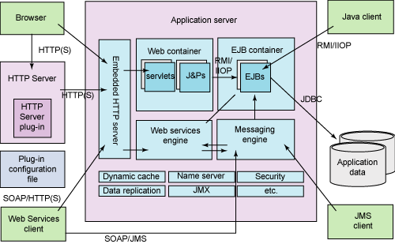
WebServer vs ApplicationServer (cont.)
Java EE compliant server ←→ Java EE Compatibility ←→ JEE Stack supported
Notes:
Briefing about JEE Stack.
Briefing about some OpenSource/Commercial Application Servers acording to JEE Stack supported (Java EE Compatibility).
JBoss AS
Tomcat
Jetty
Geronimo
GlassFish
IBM WebSphere Application Server (WAS)
BEA WebLogic
So on.
What does Java EE compliant means?
JavaEE 5, 6 or 7

Slide 8

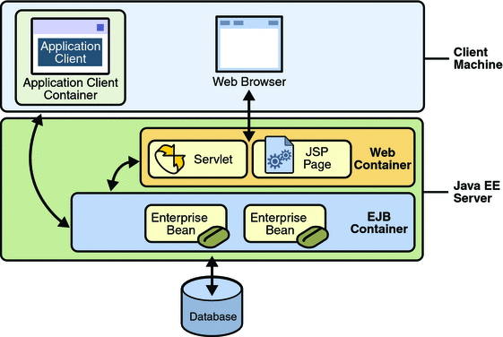
Apache Tomcat
Apache Tomcat™ is an open source software implementation of the Java Servlet, JavaServer Pages, Java Expression Language and Java WebSocket technologies.
Apache TomEE (pronounced "Tommy") is the Java Enterprise Edition of Apache Tomcat (Tomcat + Java EE = TomEE)
TomEE in October 2011, the project obtained certification by Oracle Corporation as a compatible implementation of the Java EE 6 Web Profile.
The Jakarta Tomcat server is an open source, Java-based Web application container that was created to run servlet and JavaServer Page Web applications.
Notes:
Describe advantages and limits of Tomcat when it is been developing an Enterprise Application (JEE-based Application)

Slide 9
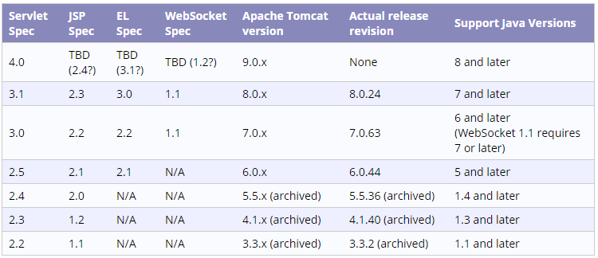
Apache Tomcat (cont.)
Servlet/JSP spec supported ← Tomcat version → Java version
Notes:
Briefing about which Java EE standards are using a Solution Software in order to choose a correct version of tools.

Slide 10
Apache Tomcat Maven Plugin
The Apache Tomcat Maven Plugin provides goals to manipulate WAR projects within the Apache Tomcat servlet container.
Deploy / Undeploy from external Tomcat Server
If you have resources (RAM) to run a Tomcat instance in your own computer.
If exists a DevServer preconfigurated to deploy the WebApplication.
It is necessary to download binary of Tomcat and to run it.
Running a embedded Tomcat
You don’t need any binary of Tomcat
It is lightweight alternative to test a Web application
Specify port where Tomcat runs
You can run your through Maven without deploying your WAR file to an Apache Tomcat instance

Slide 11

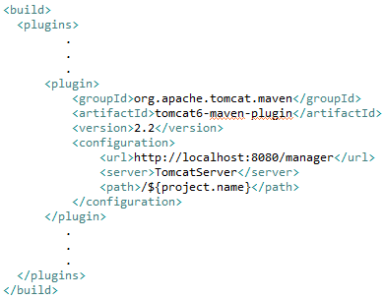

Deploy a maven WebApp to Tomcat
Configure a Tomcat user ($Tomcat_HOME/conf/tomcat-users.xml)
Configure maven to be able to login to the Tomcat manager application ($MAVEN_HOME/conf/settings.xml)
Modify the pom.xml file to include the tomcat-maven-plugin
Deploy the application to Tomcat
mvn tomcat6:deploy
mvn tomcat6:undeploy

Slide 12
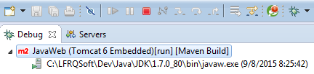
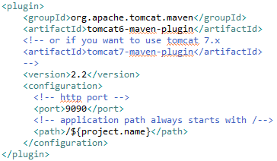
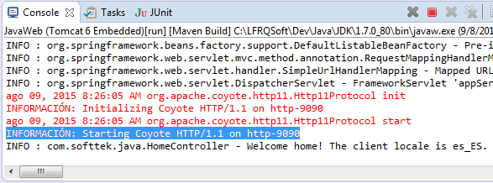
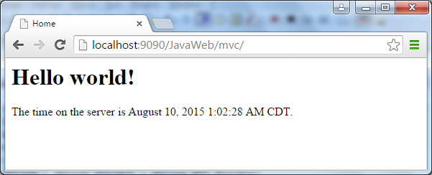
Running a embedded Tomcat
Modify the pom.xml file to include the tomcat-maven-plugin
Deploy the application to Tomcat
mvn tomcat6:clean package
mvn tomcat6:run
http://localhost:9090/JavaWeb

Slide 13
Links and References
http://docs.oracle.com/javaee/6/tutorial/doc/p1.html
http://www.oracle.com/technetwork/java/javaee/overview/compatibility-jsp-136984.html
http://tomcat.apache.org
http://tomcat.apache.org/whichversion.html
http://tomcat.apache.org/tomcat-6.0-doc/index.html
https://tomcat.apache.org/tomcat-7.0-doc/index.html
http://tomcat.apache.org/maven-plugin.html
http://tomcat.apache.org/maven-plugin-2.2/run-mojo-features.html
https://tomcat.apache.org/maven-plugin-2.2/tomcat7-maven-plugin/plugin-info.html
http://tomee.apache.org/

Slide 15
Luis Robles
luisf.robles@softtek.com
Related to training material
(Java Web module)
Erio Cesar García Lujan
erio.garcia@softtek.com
Instructor

